Slide 1
DECODE 9.2 (ML HACKATHON)
Submitted By- Raj Jadhav

Slide 2
INTRODUCTION:
Here I worked on dataset which is given by board infinity.
For this I used different graphs for visualization purpose.
I used different libraries in python like numpy, matplotlib, seaburn,sklearn.
I used different ML algorithms and check which is best.

Slide 3
PROBLEM STATEMENT:
Yenapova Medical College wants to understand their patients' data from the gynaecology department. You have been given some infant and mother’s information who have given birth to their baby. Data Analyst have collected the data from hospital. With the help of data science and machine learning, you should understand the relationship between mother and their baby.
1. Childbirth.xlsx
-Build an effective data pipeline to
-Clean the data
-Perform feature engineering
-Analyze and visualize the data
-Produce a minimum of 10 insights to report to your client.
2. Birth.xlsx
- Build a data pipeline to clean the data, perform statistical analysis and build regression model to understand relation between mother (age,weight and height) and baby’s weight
- Evaluate the model’s performance and interpret the result.

Slide 4
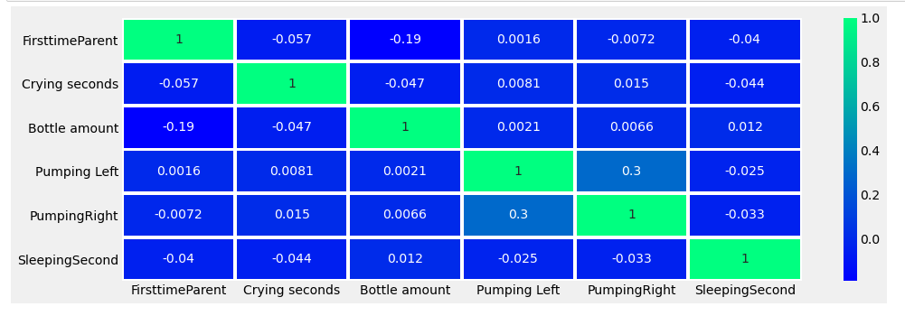
Correlation between all variables:
Here we can see there is positive correlation between bottle amount & pumping rate & between bottle amount & Sleeping second.
also there is negative relation between bottle amount & crying seconds

Slide 5
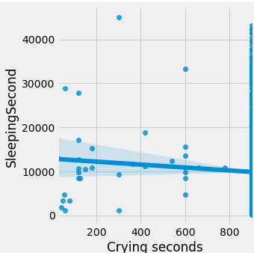
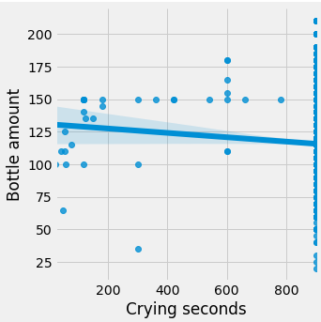
Relation between variables:
Sleeping Seconds Vs Crying Seconds
B0ttle Amount Vs Crying Seconds
Sleeping Seconds & Crying Seconds are negatively correlated i.e. more baby cried less he/she will sleep & vice versa
As bottle amount i.e. Milk drank by baby increases crying seconds decreases means more milk drank by baby more time he/she will sleep

Slide 6
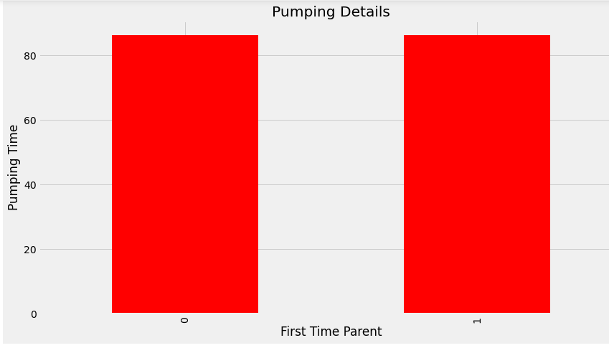
Pumping details:
There is no significant difference in pumping time whether its first time parent or not

Slide 7
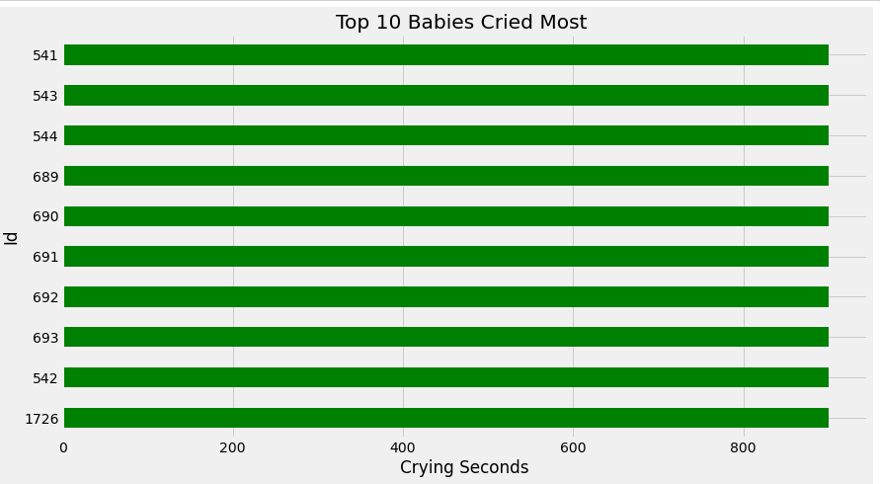
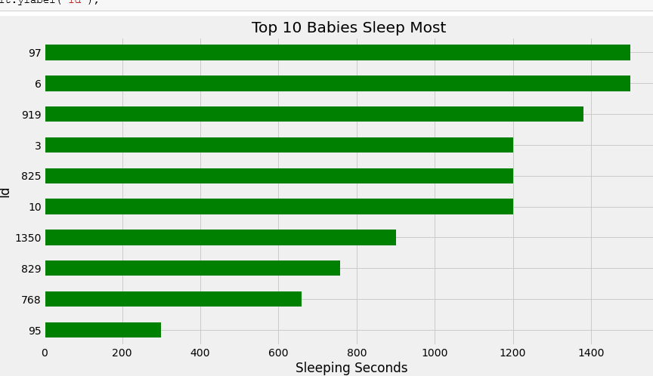
Babies details:
Top10 Babies who cried most
Top10 Babies Who Sleep Most
Yenapova Medical College need to take extra care of these babies
Seems like healthy babies among all

Slide 8
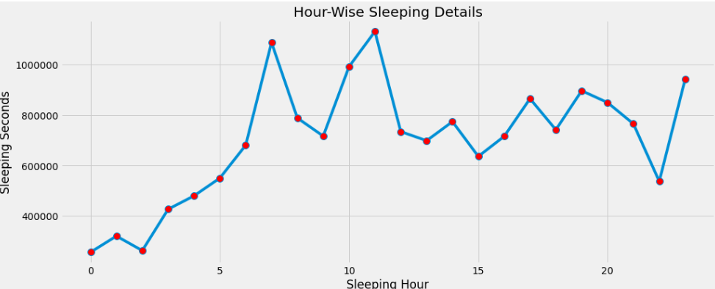
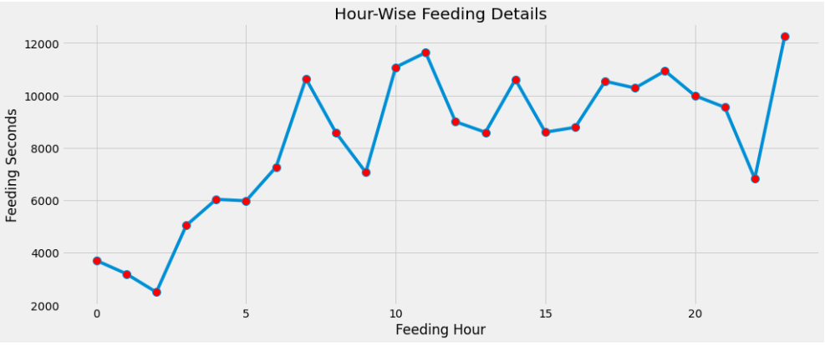
hour- Wise Information:
Hours - Wise Sleeping Details
Hour-Wise Feeding Details
Between 7 to 12 Babies sleep most
Between 1 to 5 Babies sleep less
Mostly feeding details have been taken at 11 pm

Slide 9
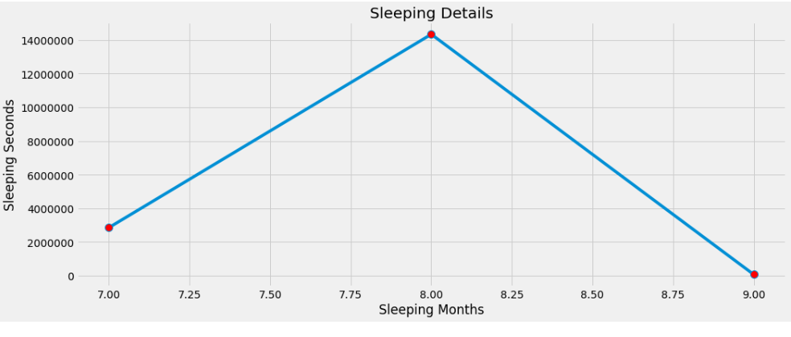
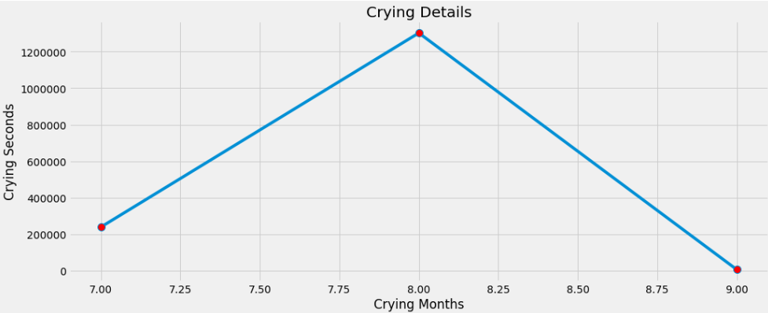
month- Wise Information:
month - Wise Sleeping Details
Month - Wise crying Details

Slide 10
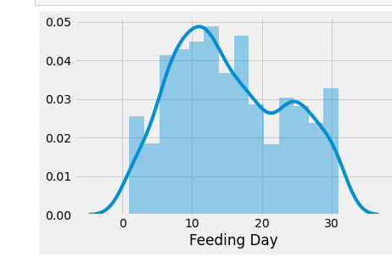
Day- wise feeding details:

Slide 11
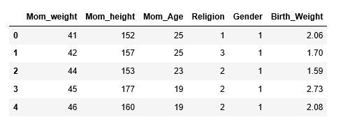
Dataset:

Slide 12
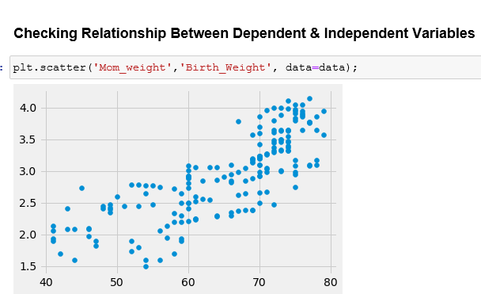
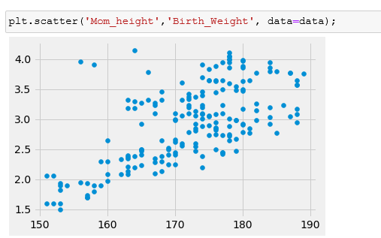
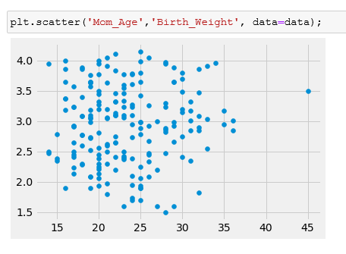
Checking Relationship:

Slide 13
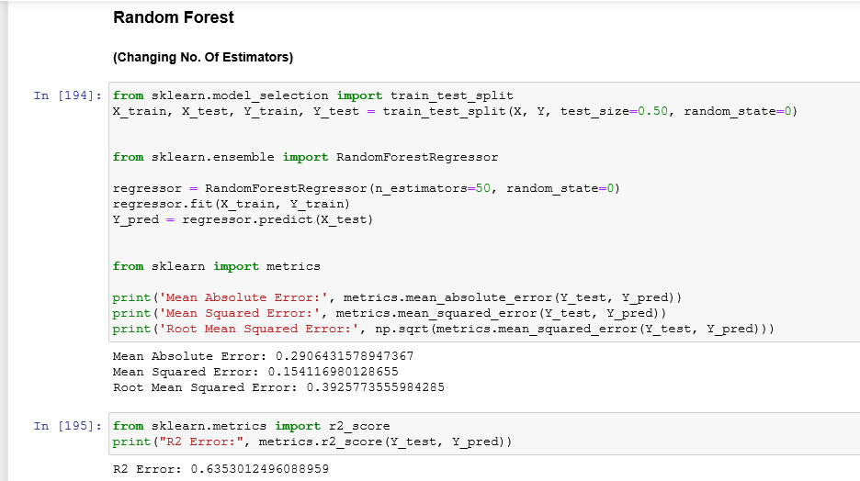
Model Making:

Slide 14
INSIGHTS:
Here we can see there is positive correlation between bottle amount & pumping rate & between bottle amount & Sleeping second.
Also there is negative relation between bottle amount & crying seconds
Sleeping Seconds & Crying Seconds are negatively correlated i.e. more baby cried less he/she will sleep & vice versa
As bottle amount i.e. Milk drank by baby increases crying seconds decreases means more milk drank by baby more time he/she will sleep
There is no significant difference in pumping time whether its first time parent or not
Between 7 to 12 Babies sleep most
Between 1 to 5 Babies sleep less

Slide 15

THANK YOU

